Slide 1
TB-Burden country Analysis
By Vaishali Burange

Slide 2
Introduction:
This project aims to analyze a comprehensive dataset on Tuberculosis (TB) to understand its prevalence, mortality rates, and related factors. By exploring various attributes such as prevalence per 100k, mortality rates, and incidence rates, we seek to gain insights into the global burden of TB and identify potential areas for intervention
The dataset comprises multiple attributes including country, population statistics, TB prevalence rates, mortality rates, and incidence rates. It covers a diverse range of countries and provides estimates for various TB-related metrics.

Slide 3
Content:
1) Country
2) ISO_2
3) ISO_3
4) ISO_numeric
5) total_population
6) prevalence_of_TB_100k
7) prevalence_of_TB_100k_low
8) prevalence_of_TB_100k_high
9) prevalence_of_TB
10) prevalence_of_TB_low_bound
11) prevalence_of_TB_high_bound
12) Method_prevalence_estimates
13) mortality_of_TB_100k
14) mortality_of_TB_100k_low
15) mortality_of_TB_100k_high
16) deaths_from_TB
17) deaths_from_TB_low
18) deaths_from_TB_high
19) mortality_HIV_per_100k
20) Death
21) Deaths_HIV_high
22) Method_mortality
23) incidence_per_100k
24) incidence_per_100k_low
25) incidence_per_100k_high
26) Incident_cases
27) Incident_cases_low
28) Incident_cases_high
29) Method_incidence
30) Inc_HIV_per_100k
31) Inc_HIV_per_100k_low
32) Inc_HIV_per_100k_high
33) Inc_TB_HIV
34) Inc_TB_HIV_low
35) Inc_TB_HIV_high
36) Case_detect_rate_percent
37) Case_detect_rate_percent_low
38) Case_detect_rate_percent_high

Slide 4
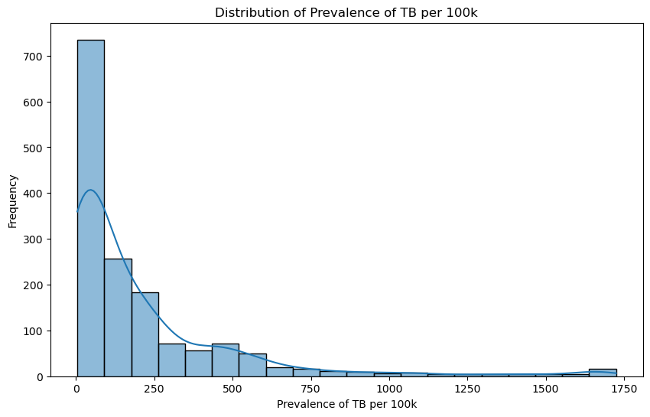
1)Distribution of Prevalence of TB per 100k
Conclusion:
The distribution of TB prevalence per 100k individuals exhibits a right-skewed pattern, indicating a higher frequency of lower prevalence rates.

Slide 5
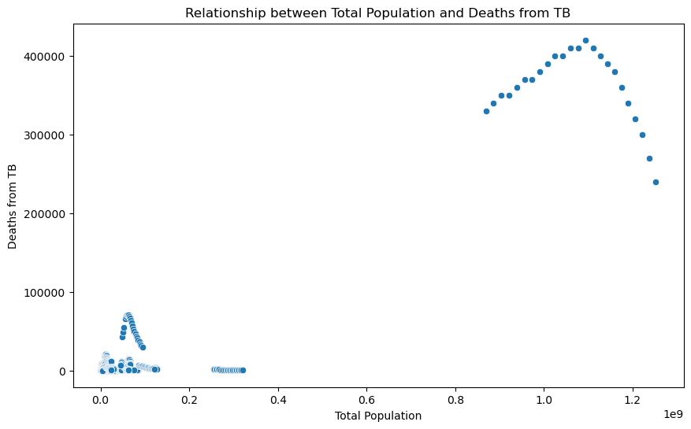
2)Relationship between Total Population and Deaths from TB
Conclusion:
The correlation coefficient of 0.93 suggests a strong positive correlation between Total Population and Deaths from TB, indicating that regions with larger populations tend to experience higher TB-related mortality rates

Slide 6
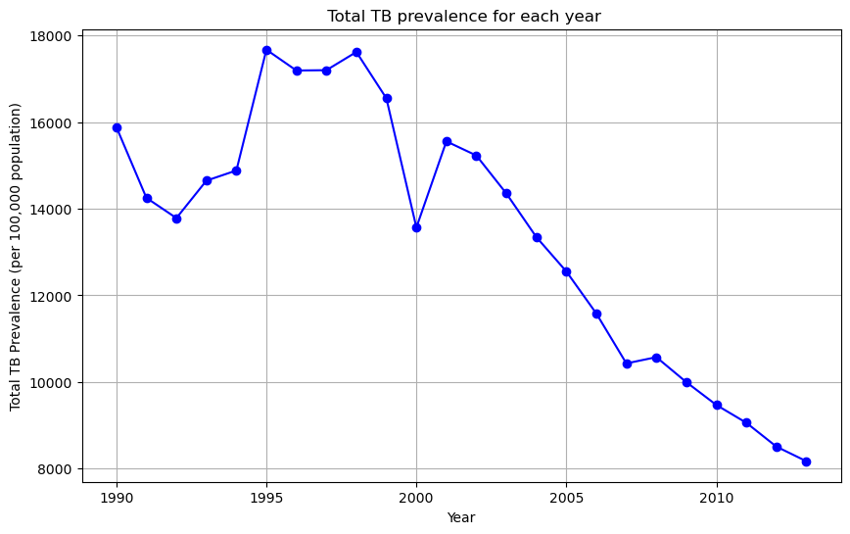
3)What is the trend in TB prevalence year wise?
Conclusion:
TB prevalence exhibited a declining trend from its highest point in 1995 (17672.7) to its lowest point in 2013 (8168.2), indicating a notable decrease in TB burden over the years.

Slide 7
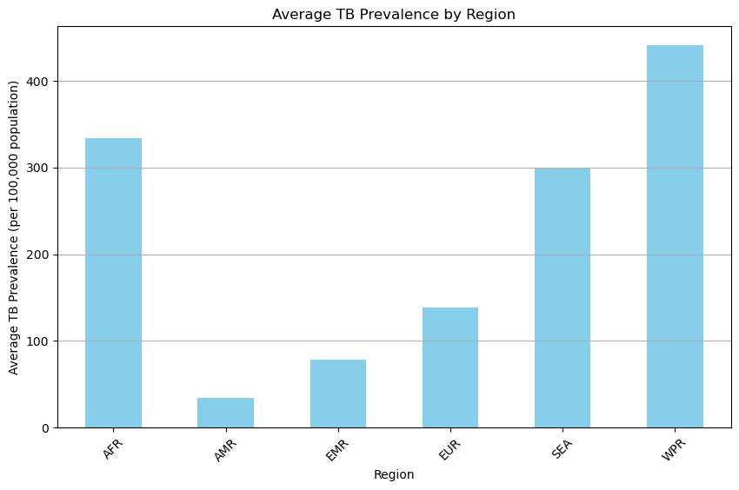
4)What are the TB prevalence rates across different regions?
Conclusion:
TB prevalence rates vary significantly across regions, with the highest prevalence observed in the Western Pacific Region (440.74) followed by the African Region (334.07), while the lowest prevalence is observed in the Americas Region (34.16), indicating substantial regional disparities in TB burden.

Slide 8
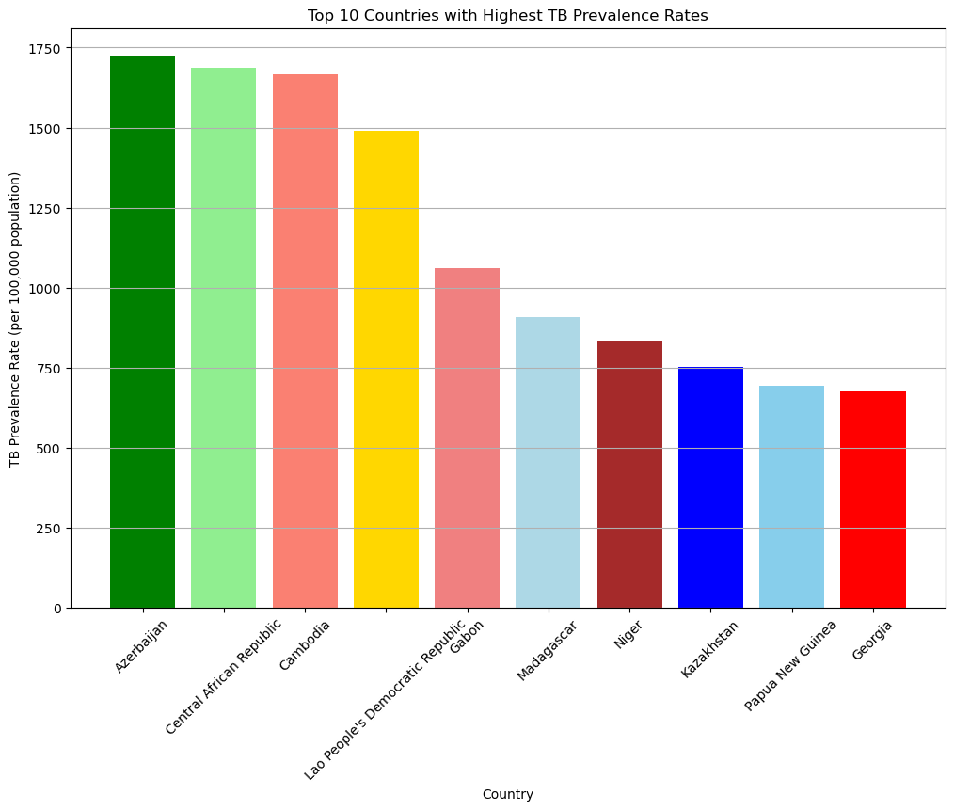
5)Which top 10 countries have the highest TB prevalence rates?
Country
Azerbaijan 1725.0
Central African Republic 1686.0
Cambodia 1667.0
Lao People's Democratic Republic 1491.0
Gabon 1060.0
Madagascar 909.0
Niger 834.0
Kazakhstan 753.0
Papua New Guinea 694.0
Georgia 674.0
Conclusion:
The top 10 countries with the highest TB prevalence rates are Azerbaijan (1725.0), Central African Republic (1686.0), Cambodia (1667.0), Lao People's Democratic Republic (1491.0), Gabon (1060.0), Madagascar (909.0), Niger (834.0), Kazakhstan (753.0), Papua New Guinea (694.0), and Georgia (674.0). These countries exhibit the highest burden of TB, reflecting the urgent need for targeted interventions to address TB control and prevention efforts.

Slide 9
6)Which country has the highest number of incident TB cases?
Country with the highest number of incident TB cases: India
Conclusion:
India has the highest number of incident TB cases, reflecting a significant burden of TB within the country. This underscores the pressing need for comprehensive TB control strategies to mitigate the impact of the disease

Slide 10
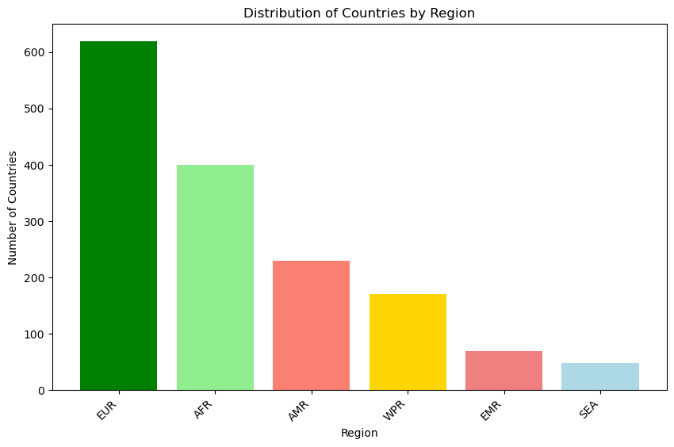
7)What is the distribution of countries by region?
Region
EUR 619
AFR 400
AMR 230
WPR 171
EMR 69
SEA 48
Conclusion:
The distribution of countries by region shows that the European Region (EUR) has the highest number of countries (619), followed by the African Region (AFR) with 400 countries. Conversely, the Southeast Asia Region (SEA) has the lowest number of countries, totaling 48.

Slide 11
8)Which country has the highest mortality rate from TB?
Country with the highest mortality rate from TB: Central African Republi
Conclusion:
The Central African Republic exhibits the highest mortality rate from TB, indicating a severe impact of the disease within the country. This underscores the urgent need for targeted interventions to reduce TB-related deaths and improve public health outcomes.

Slide 12
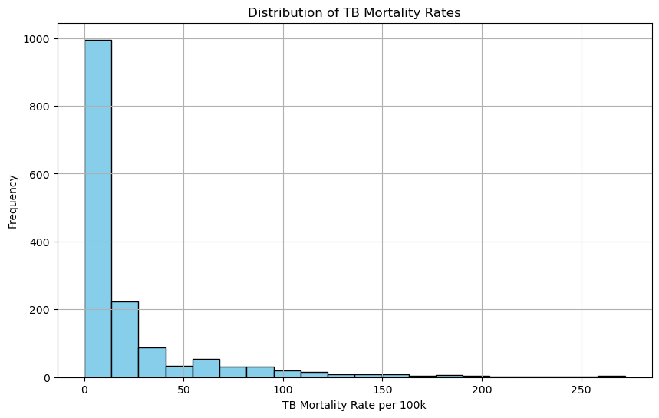
9)What is the average mortality rate of TB per 100k population?
Average mortality rate of TB per 100k population: 21.491093038386467
Conclusion:
The average mortality rate of TB per 100k population is 21.49, reflecting the significant impact of TB-related deaths globally

Slide 13
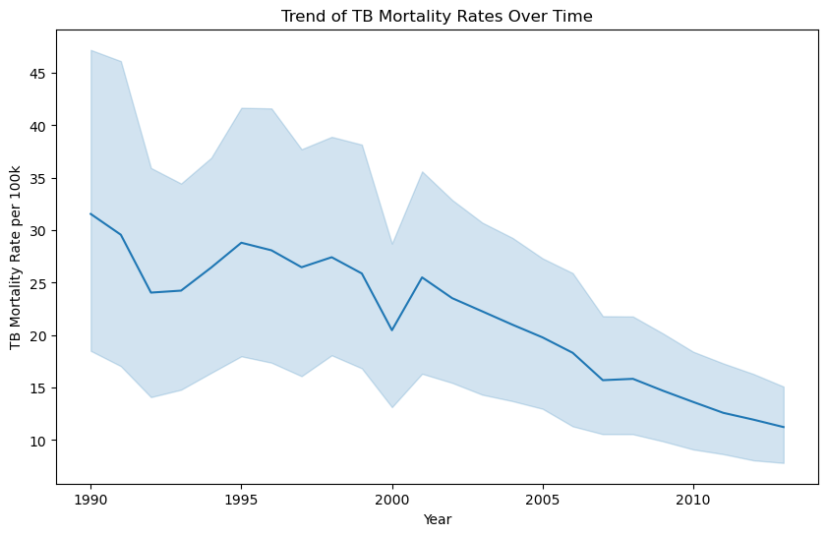
10)Is there any trend in TB mortality rates over time?

Slide 14
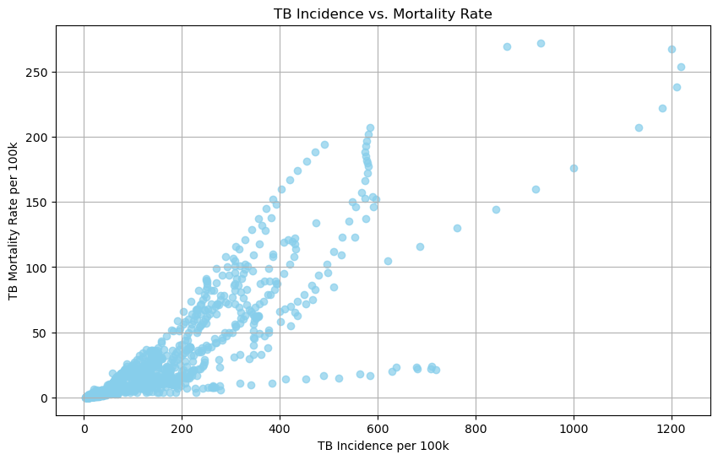
11)correlation between TB incidence and mortality?

Slide 15
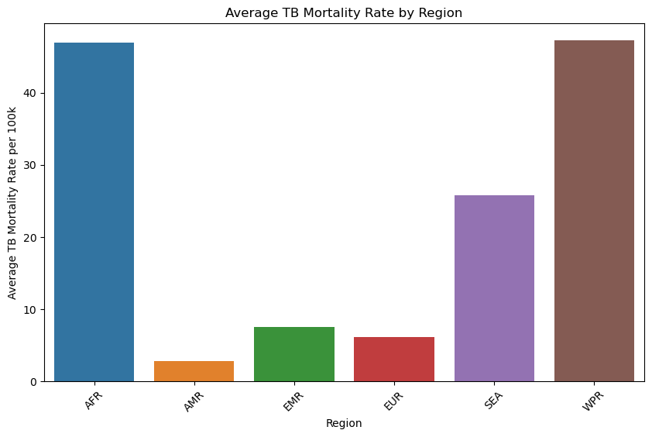
12)How does the TB mortality rate differ across different regions?

Slide 16
13)Which region has the highest case detection rate?
Region with the highest case detection rate: AFR
Conclusion:
The African Region (AFR) boasts the highest case detection rate, indicative of effective TB diagnosis and surveillance efforts. This highlights the importance of robust healthcare systems and targeted interventions in improving TB detection and treatment outcomes.

Slide 17
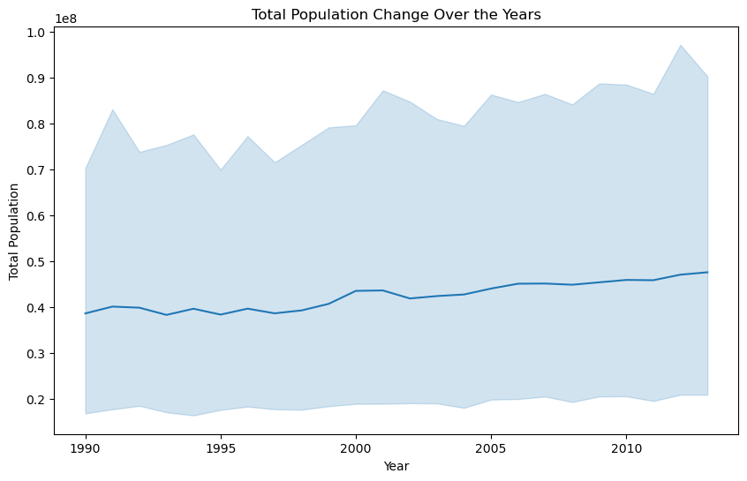
14)How has the total population changed over the years?

Slide 18
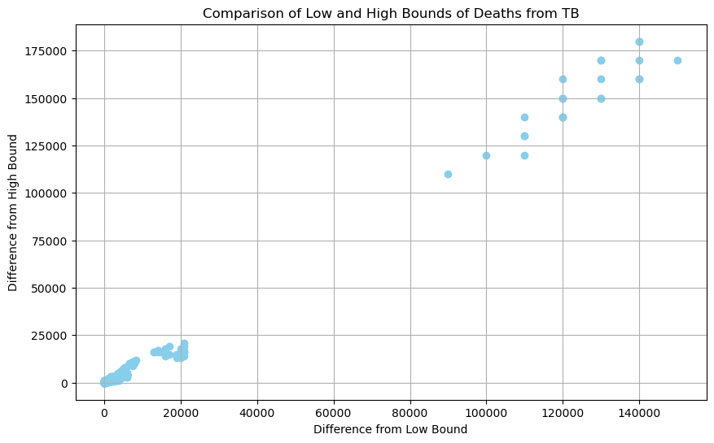
16)How do the reported low and high bounds of deaths from TB compare to the actual reported values?

Slide 19
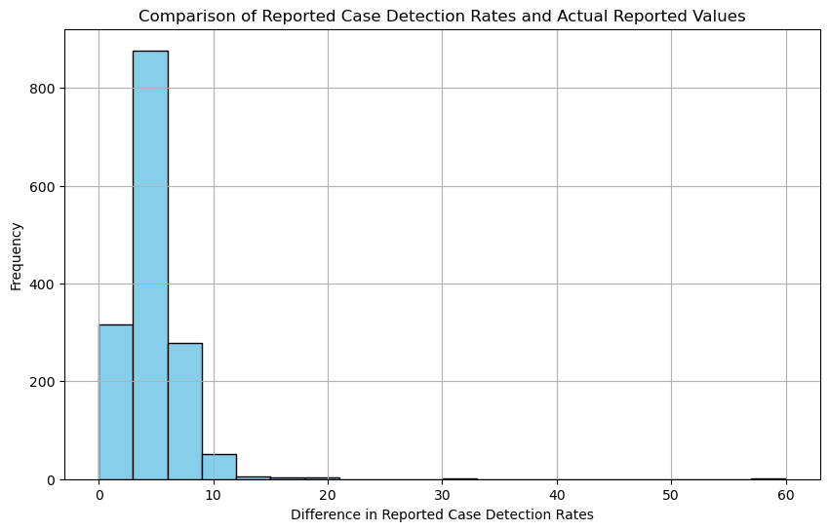
17)correlation between mortality rate due to HIV and TB mortality rates?
Correlation between mortality rate due to HIV and TB mortality rates: 0.5641777769270504
18)How do the reported case detection rates of TB compare to the actual reported values?

Slide 20
Thank You

